Slide 1
Android Games Analysis – Why Does my playtime reduce my talk time?
Team – Hunger-Games
Milind Gokhale
Renuka Deshmukh

Slide 2


Motivation
Games => 16% of the total time spent on mobile apps in US. _{COMSCORE}
Appeal to diverse group of audience
Advent of modern technology and higher configuration => innovative games
Mobile game revenues will reach $28.9Bn by 2016, up 38% from 2014.

Slide 3
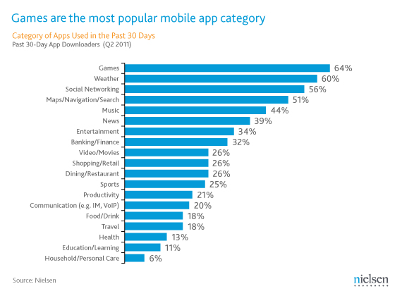
Most popular mobile app category

Slide 4



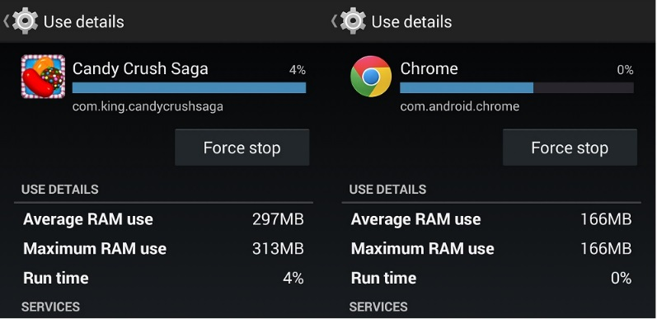

However there are problems
High Battery Usage
High Data Usage
High Memory Usage
Performance Slowdown

Slide 5
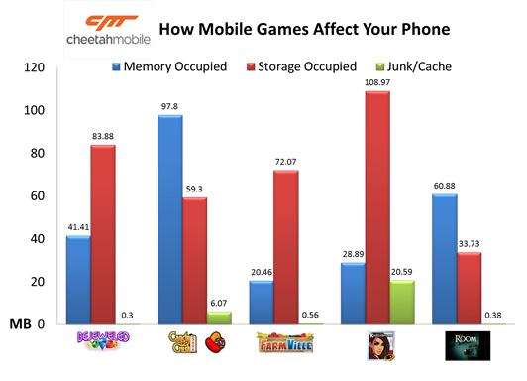
Related Work
Study by Cheetah Mobile

Slide 6
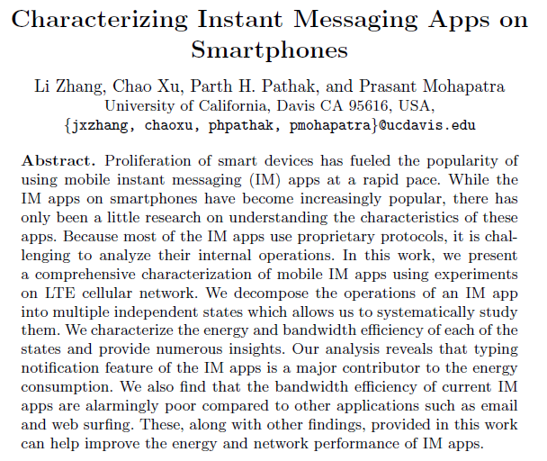

Related Work
Verizon Wireless – High Risk Apps
Characterizing Instant Messaging Apps on Smartphones
http://www.verizonwireless.com/support/high-risk-android-apps/

Slide 7
Project Idea
What can be done?
Trying to find the root cause of inefficiencies in online mobile games in terms of memory usage, data usage and performance.
Approach
Data Collection
Analysis
Recommendation

Slide 8
Methodology
Game States
Experiment Setup
Games
Tools
Test Subjects
Test Cases
Testing Steps and Analysis Approach

Slide 9





Game States
Foreground
Idle
Playing
Background

Slide 10





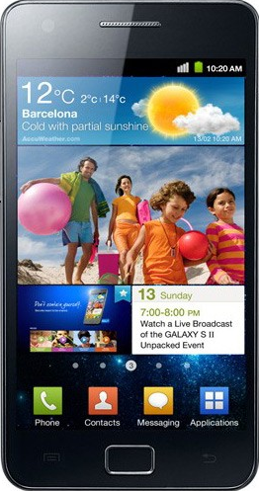

Experiment Setup

Slide 11




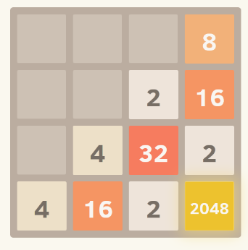
Games and Tools
Farm Heroes Saga
Social
2048
Casual
ARO
Wakelock Detector
Power Tutor
Usemon

Slide 12
Test Design
No need of test subjects
 | Description | Network Channel
1 | Game Screen On, Idle | No Internet/Wi-Fi/LTE
2 | Game Playing | No Internet/Wi-Fi/LTE
3 | Ad Statistics | Wi-Fi/LTE
4 | App in background | Wi-Fi/LTE

Slide 13
Test Execution
Execution steps and
Metrics

Slide 14
Findings

Slide 15
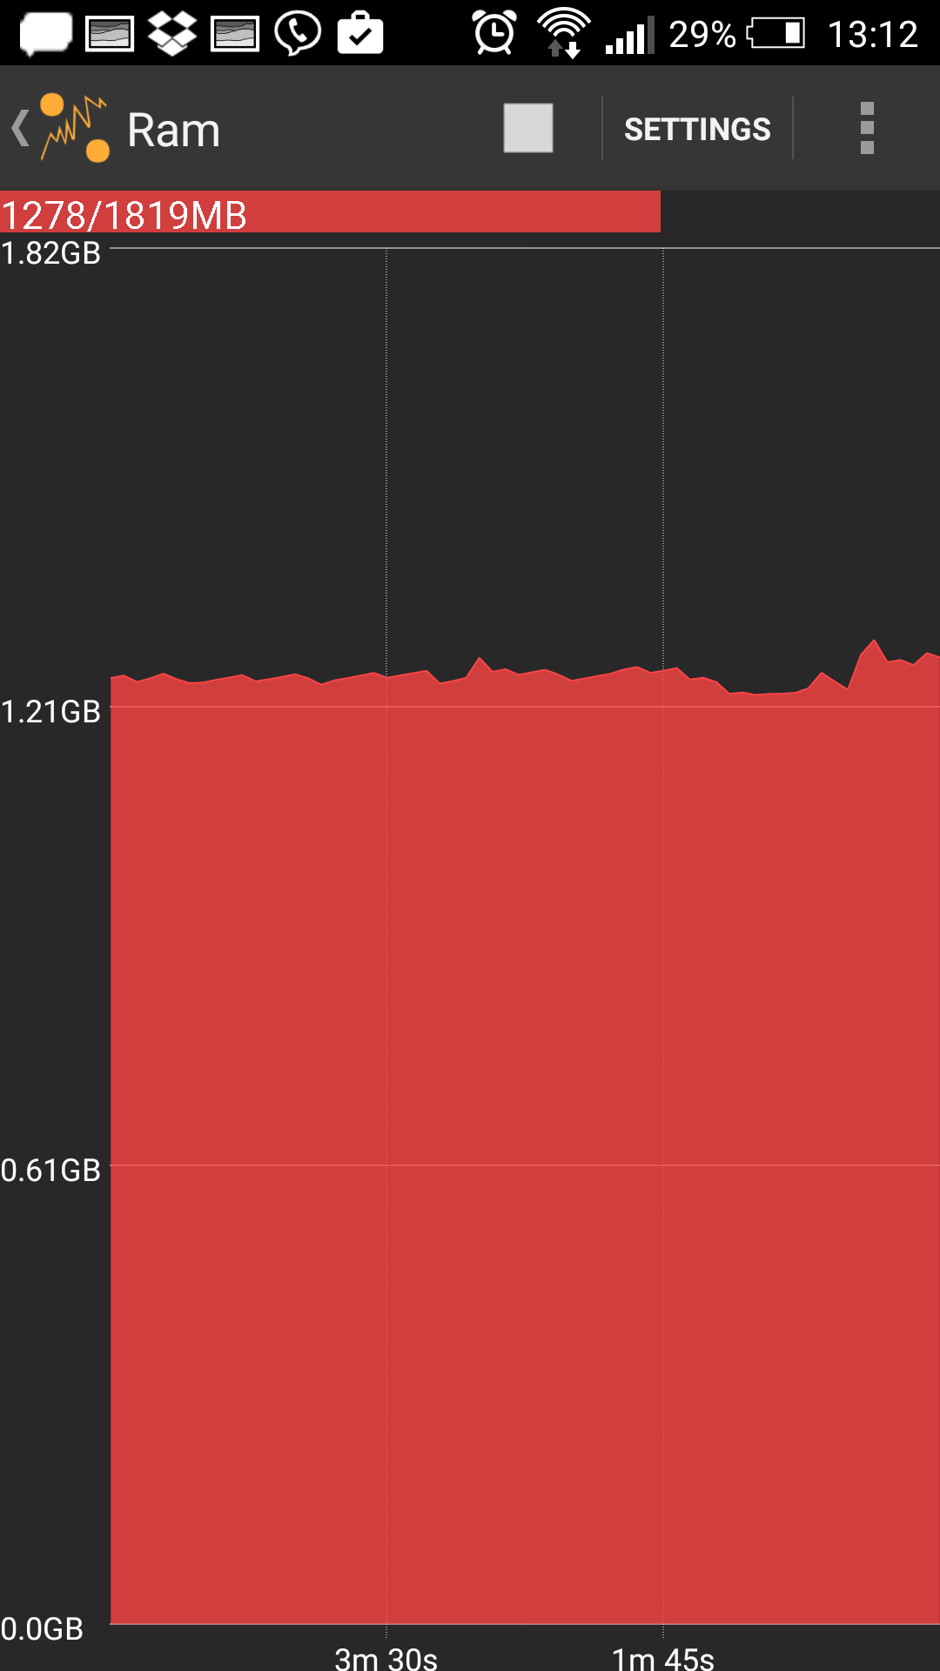
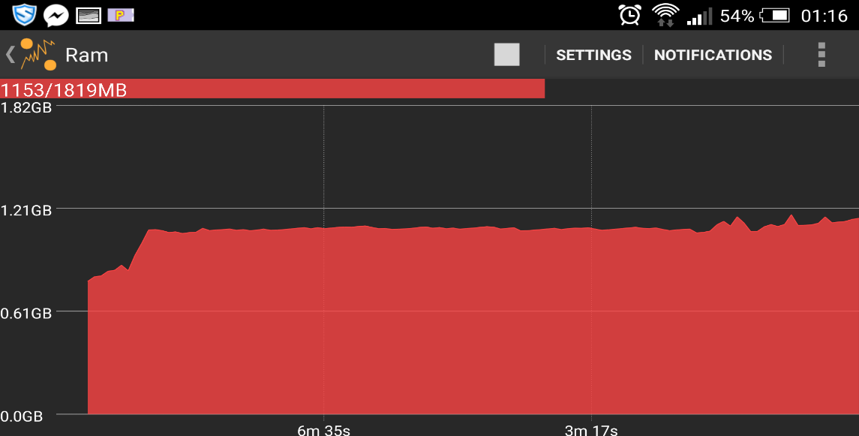
High RAM Usage
More than 1 GB of RAM used while playing 2048 and Farm Saga.

Slide 16
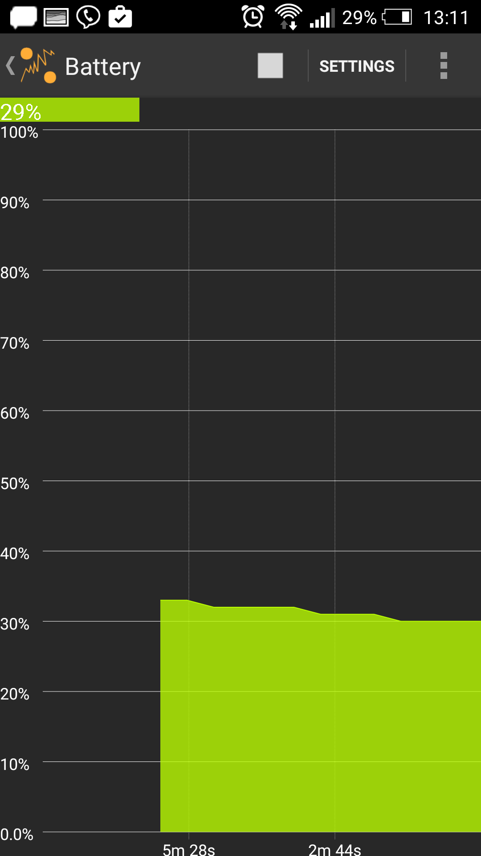
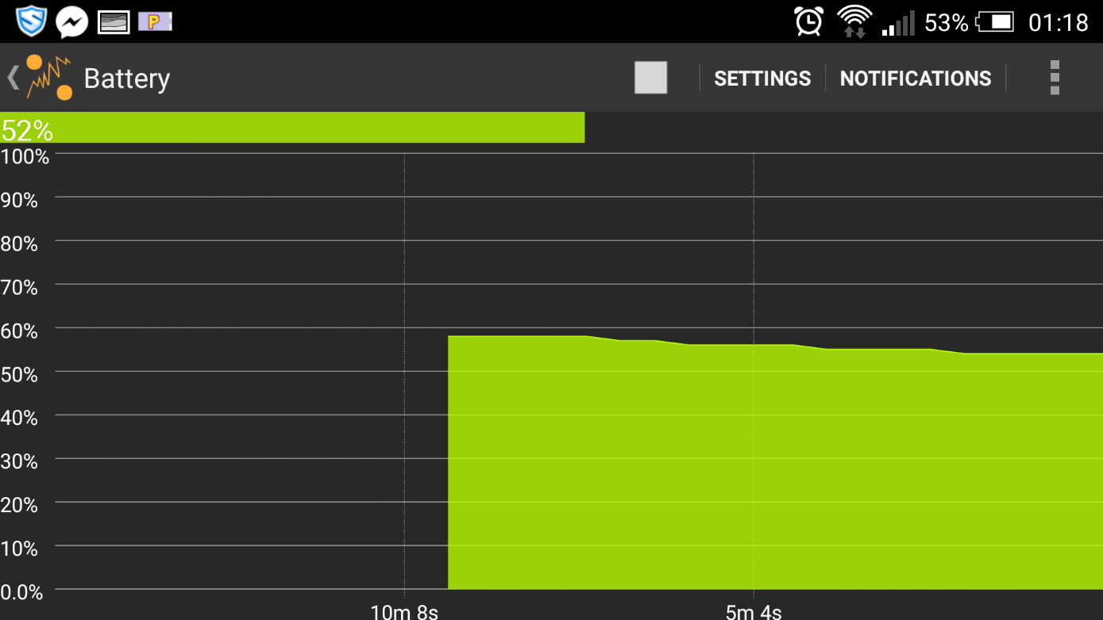
High Battery Consumption
While playing 2048 and Farm Saga
9% (59% to 52%) in about 9 mins
Hence – Full battery drain in 100 mins

Slide 17
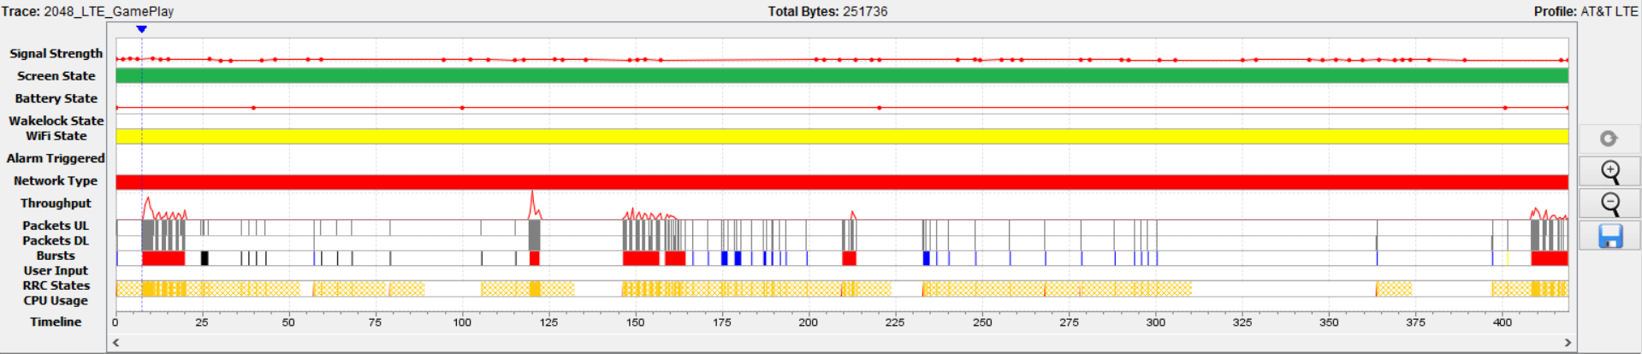
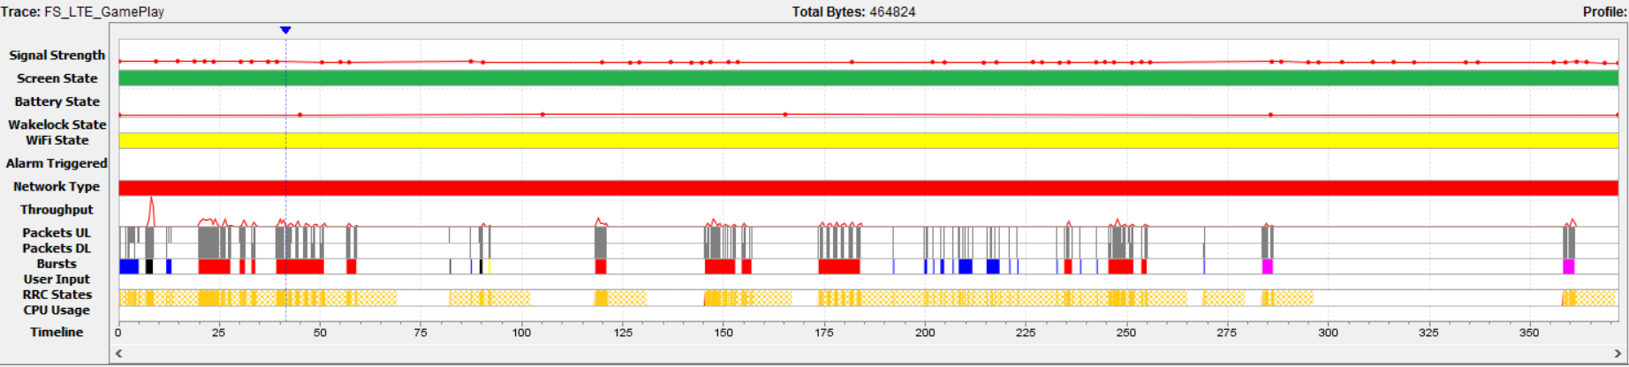
Unexpected High Data Usage
2048 & Farm Saga Using high data in LTE

Slide 18
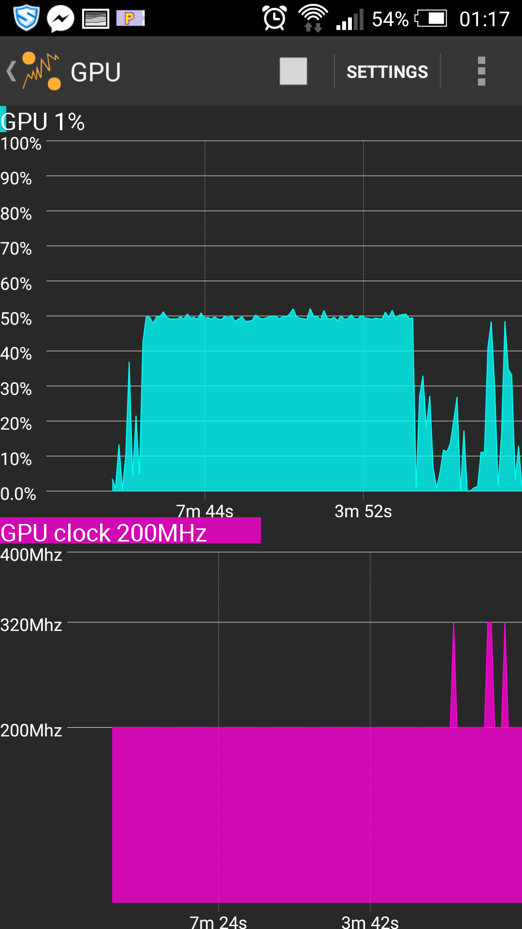
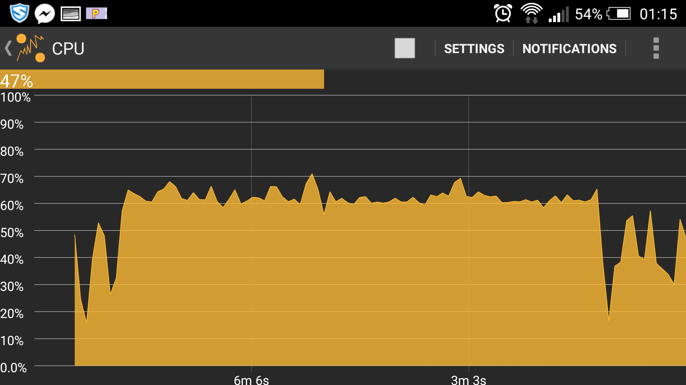
Performance Slowdown
High CPU Usage
High GPU Usage

Slide 19
Findings: Foreground - Idle
Screen ON
RRC States
Connection Bursts Grouping

Slide 20
Findings: Foreground - Playing
Connection Closing
Duplicate TCP Content

Slide 21
Findings: Background

Slide 22
Ad Stats
Uncompressed Files
Javascript, HTML, CSS and text files should be minified
CSS Rule “display:none;”
Content not displayed on page should be removed from HTML
Probable Ad Fraud
Heuristic to detect the game session end
Domains Accessed (2048 Gameplay)
Row Labels | Requests per domain | Sum of Byte Count | Sum of Packet Count
ads.get.it | 3 | 131530 | 264
ads.mopub.com | 6 | 5899 | 32
android.clients.google.com | 2 | 8088 | 31
cpp-test.imp.mpx.mopub.com | 3 | 3773 | 22
get.it | 6 | 5607 | 51
in.metamx.com | 3 | 3697 | 21
play.googleapis.com | 3 | 384 | 6
rtb-05.get.it | 5 | 4966 | 41
Grand Total | 31 | 163944 | 468

Slide 23

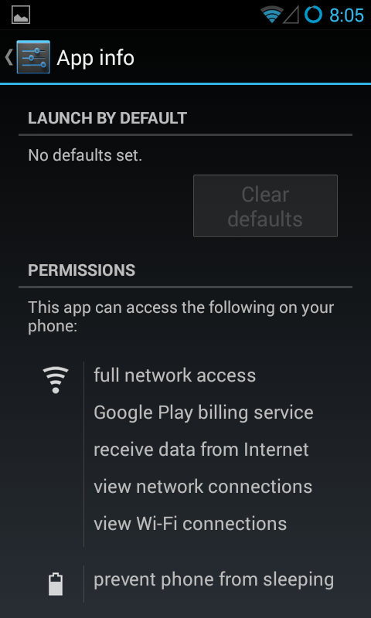
Wakelocks
Wakelocks should not be misused.
If there is no user interaction turn off screen
User Privacy
HTTPS Connections

Slide 24
Challenges – Get it from the Status report
Time Constraint
Focused to particular cluster of mobile gamers within students from IUB.
Data collection and user availability
Identify potential set of gamers to play these games for the purpose of our study.
Data Isolation
Allot timeslots for tests with only game running on device
Collect two sets of data with and without gameplay and take the difference of the two sets
High bandwidth data usage collection
Acquire a SIM with unlimited data plan for the study and execute multiple runs of games on phones using the SIM.

Slide 25
Future Work
Code Analysis
Other types of games
Code Offloading
iOS Devices
Recommendation Implementation
Study Other Resources

Slide 26
Conclusion

Slide 27
Timeline
Feb 13, 2015 – Feb 20, 2015: Design
Identifying test subjects.
Initial Design, Tools and installations.
Games finalization
Hardware acquisition (SIM and phones if required)
Feb 21, 2015 – Mar 20, 2015: Implementation
Data Collection Phase
Mar 21, 2015 – Apr 10, 2015: Evaluation
Data Analysis and Recommendation
Apr 11, 2015 – Apr 30, 2015: Project Report

Slide 28


End goal
Industry perspective
Better games and efficient resource consumption
Increase in games usage and revenues
End-user perspective
Controlled data usage
Better performance
Better battery life

Slide 29

Thank you
Questions

